Slide 1
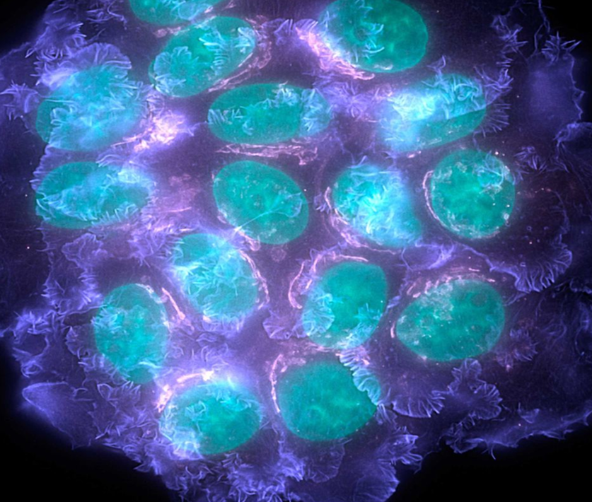
Representing and supporting Medical Oncologists in the UK
Medical Oncology
- responsible for overseeing the treatment of patients with cancer
theacp.org.uk @ACPUK
Notes:
If this is to be used on a careers fair stand – then you will need to activate transitions (Transitions, Advance slide, after, 8 seconds)
If you are using this to present to students/doctors then replace the line on the title page with your details.
Students will often want contacts to sit in on clinics, contacts for taster weeks or to get involved with audits.
It may be useful to have some friendly oncologists who will be willing to engage with keen trainees
There is an associated leaflet and poster with this presentation that you may wish to print and distribute. It includes links to these websites and a broad overview of medical oncology – This can be downloaded from the ACP website.

Slide 2
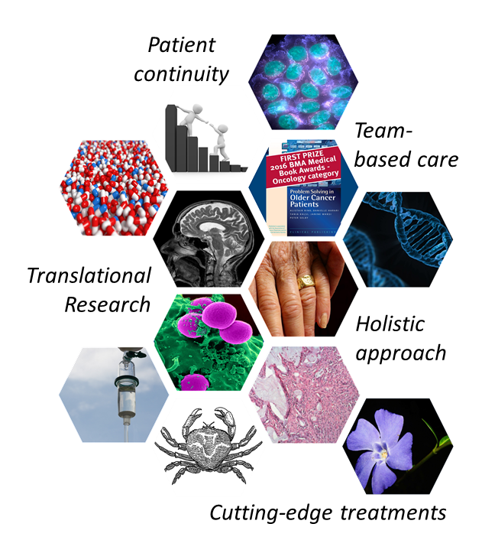
Dynamic, Challenging and Rewarding
@acpuk
theacp.org.uk
Notes:
Overview of Medical Oncology and outline of presentation
Pictures – Top – Cancer Cells
Tablets/Targeted treatments
Book – Award winning ACP Publication on ‘Problem Solving in Older Cancer Patients’
MRI Head
T-Cell
Histology – Lung Cancer
Crab (Origins of the name cancer)
Flower – Periwinkle (Vinca Alkaloids)

Slide 3
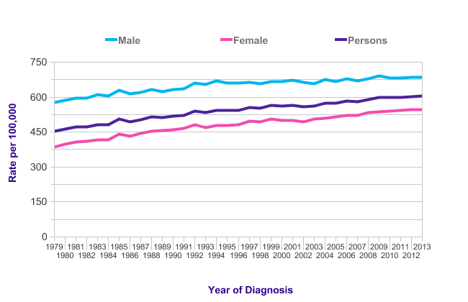

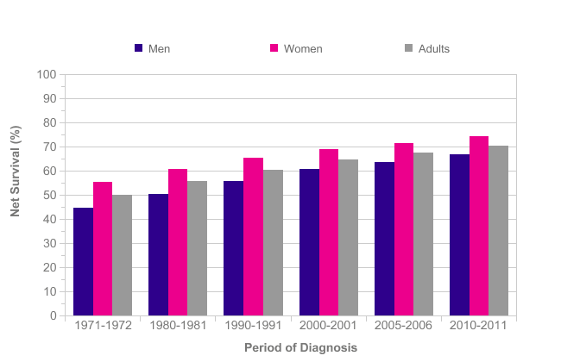
Increasing incidence
Increasing survival
Increasingly complex
@acpuk
theacp.org.uk
Notes:
Incidence:
352 197 cases of cancer in the UK each year (2013)
Every two minutes someone in the UK is diagnosed with cancer.
Since the late 1970s, incidence rates for all cancers combined have increased by almost a third (30% increase) in Great Britain.
Incidence rates for all cancers combined are projected to rise by 2% in the UK between 2014 and 2035, to 742 cases per 100,000 people by 2035.More than two million people in the UK are estimated (in 2008) to be alive having previously been diagnosed with cancer.
Survival:
Half (50%) of people diagnosed with cancer in England and Wales survive their disease for ten years or more (2010-11)
Age-standardised net survival for patients diagnosed with all cancers combined during 2010-2011 in England and Wales show that 67% of men survive their disease for at least one year, and this is predicted to fall to 49% surviving for five years or more.[1] Survival for women is slightly higher, with 74% surviving for one year or more, and 59% predicted to survive for at least five years.

Slide 4

What is Medical Oncology and what makes it great?
@acpuk
theacp.org.uk
Notes:
We asked our trainees – what is medical oncology and what makes it great?
Personal experience of medical oncology/what makes it great for you?
Explore some of these issues in this presentation
Including exciting treatments, continuity of care and multidisciplinary working (next slide)

Slide 5
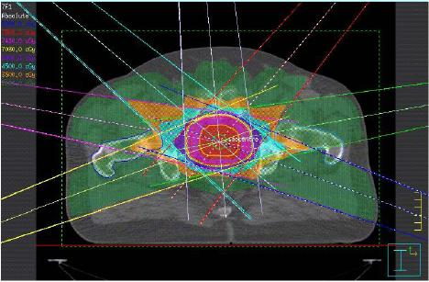
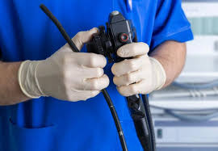
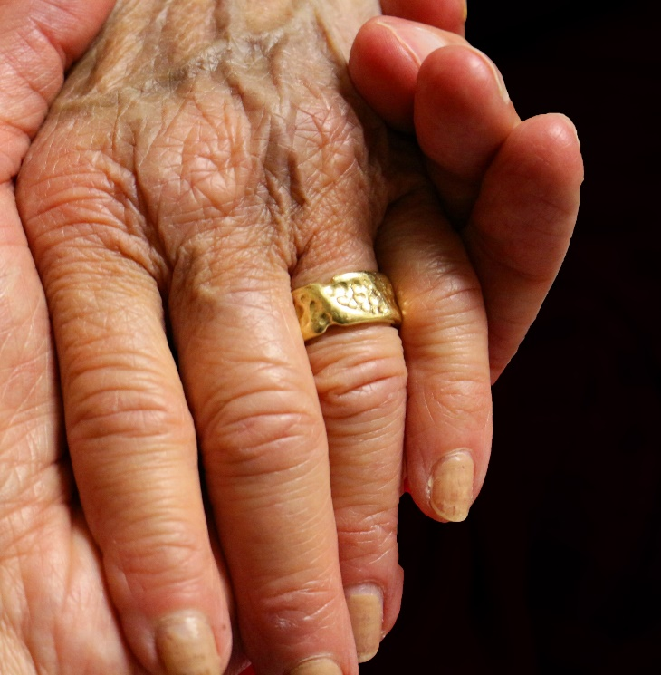
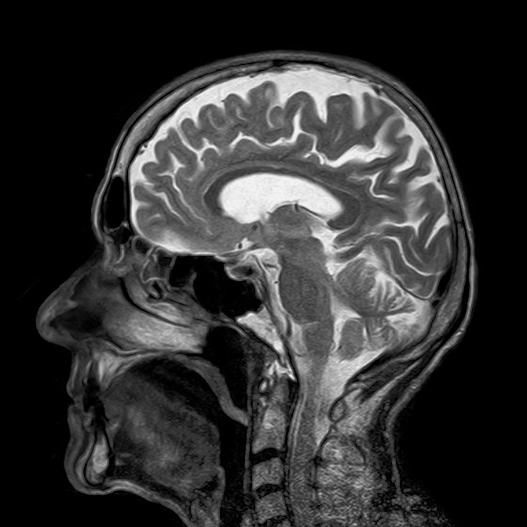
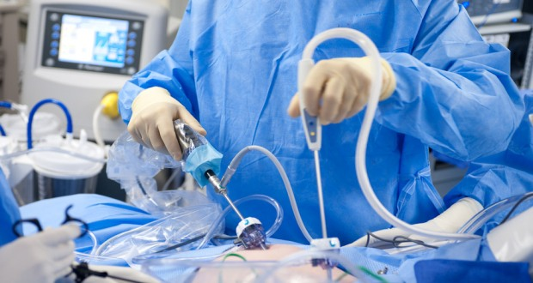
MDT approach
Clinical Oncology
Surgeons
Palliative Care
Medical Specialties
Radiologists
@acpuk
theacp.org.uk
Notes:
… and not forgetting the invaluable allied health care professionals – clinical nurse specialists, pharmacists, chemotherapy nurse, physiotherpaies, OTs, Dieticians etc
Truly a team/multi-disciplinary and holistic approach to cancer care

Slide 6
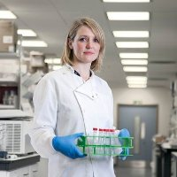
Academic Career Opportunities
Eileen Parkes
Academic Clinical Lecturer and Medical Oncology Trainee, Belfast
“
I love medical oncology because it is a particularly exciting time with the expansion of targeted and immunotherapies. We have the opportunity to use these cutting edge treatments for patient benefit. There have been dramatic improvements in treatment and I'm excited to see that continuing
@acpuk
theacp.org.uk
”
Notes:
Quote of a trainee – exited about ‘targeted treatments and immunotherapy’ – discussed in next few slides

Slide 7
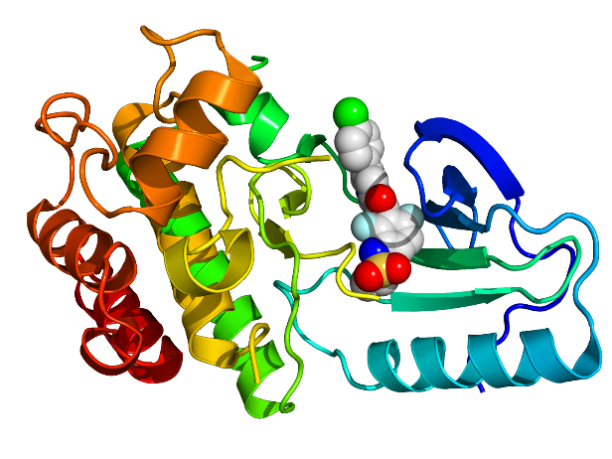
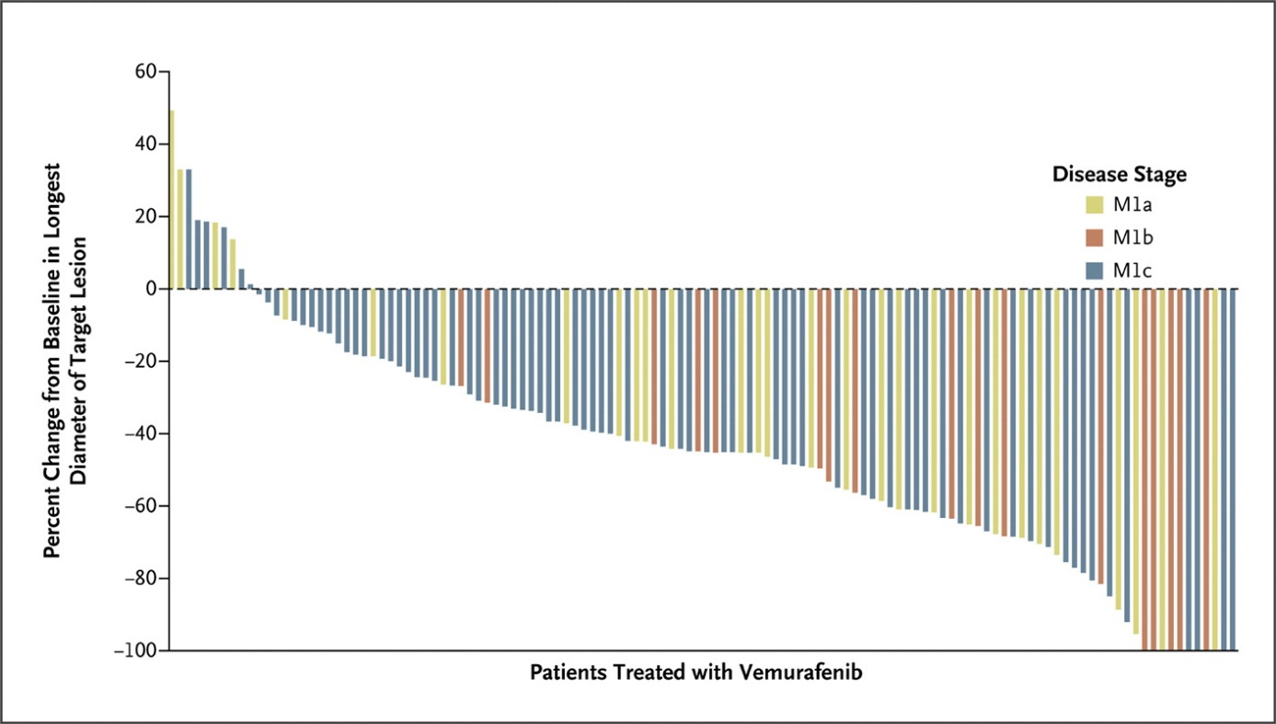

Exciting new Treatments:
- Targeted therapies
Vemurafenib in Malignant Melanoma
Targets BRAF mutations - the cancer’s achilles heel
@acpuk
theacp.org.uk
Sosman JA et al. N Engl J Med 2012;366:707-714.
Notes:
Initial publication in 2012.
Dramatic responses seen in patients with BRAF mutant melanoma (Waterfall plot)

Slide 8
Exciting new Treatments:
- Targeted therapies
Vemurafenib in Malignant Melanoma
… but the cancer develops resistance mechanisms
@acpuk
theacp.org.uk
Sosman JA et al. N Engl J Med 2012;366:707-714.
Notes:
Although resistance occurs
Importance of understanding the molecular pathways as we can now start addressing the resistance mechanism to develop new drugs

Slide 9
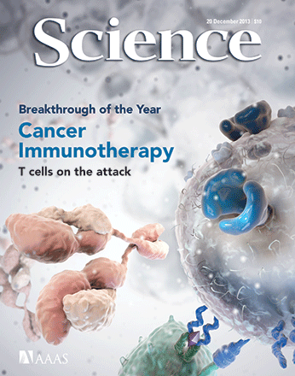
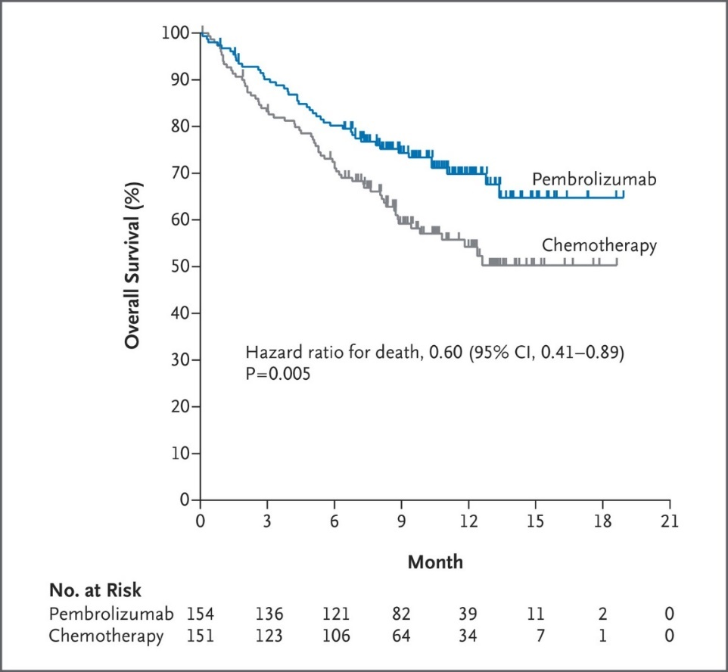
Pembrolizumab in Lung Cancer
Exciting new Treatments:
Immunotherapies
Targets PD-1 at the immune synapse and ‘takes the brakes off the immune system’
@acpuk
theacp.org.uk
Reck M et al. N Engl J Med 2016
Notes:
Using IO in more and more cancers. Initially in Melanoma as in the last case.
But now in more common cancers like lung cancer
Exciting – priming the immune system to attack the cancer

Slide 10
Pembrolizumab in Lung Cancer
Exciting new Treatments:
Immunotherapies
Targets PD-1 at the immune synapse and ‘takes the brakes off the immune system’
???
@acpuk
theacp.org.uk
Reck M et al. N Engl J Med 2016
Notes:
The Plateau of these kaplin-mayer curves is an exciting prospect as in Melanoma these plateaus have extended out to 5 years … and we are now talking about the prospect of the ‘C’ (cure) word in patients with metastatic disease treated with systemic treatment (by MEDICAL ONCOLGOISTS!).
HOWEVER we also give treatments in the neo-adjuvant (explain) and adjuvant settings and in multi-modality approaches.
So – as you can see – there is still much to do …
And that’s why we need you … and here is how to get into medical oncology

Slide 11
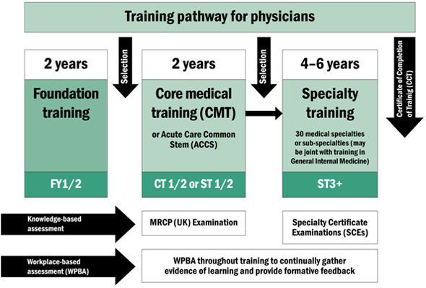
Training Pathway
@acpuk
theacp.org.uk
Notes:
Current training pathway

Slide 12
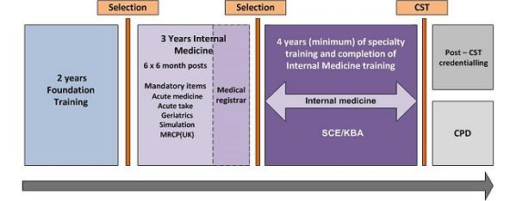
Training Pathway
New Shape of Training
@acpuk
theacp.org.uk
Notes:
Introduction of Shape of Training in 2018 (bottom up – i.e. only for new trainees entering Core Medical Training at CMT1)
Changes – Extra year in general medical training (‘CMT3’ year – which will involve being a junior registrar) prior to specialty selection
Then after ST3 – apply to and become a medical oncologist.
Currently we are not part of the ‘unselected medical take’ and instead provide advice and admissions through acute oncology services (Acute ‘Selected’ take in oncology)
I will run through each section briefly with some tips on how to help get into medical oncology

Slide 13
Top tips During Training
Medical School ( 5/6 Years)
Apply for undergraduate prizes (ACP Prizes)
Join university oncology societies (including BONUS)
Attend undergraduate oncology conferences (Christie, BONUS)
Special study modules in oncology
Electives in oncology
@acpuk
theacp.org.uk
Notes:
Undergraduate Essay prize – £200, Good for CV. Released 1/year – Keep an eye on twitter/website for opening/closing dates
Links to these conferences and societies are on our website

Slide 14
Top tips During Training
Medical School ( 5/6 Years)
Develop your portfolio and CV demonstrating a commitment to oncology – Audits with local oncologists
Attend Careers Events
Talk to your local friendly oncologist!
Visit the ACP website for more information – theacp.org.uk
@acpuk
theacp.org.uk

Slide 15
Top tips During Training
Foundation Years – 2 years
Attend careers fairs and conferences, apply for ACP oncology prizes
Develop your portfolio and CV demonstrating a commitment to oncology – Audits, Quality improvement Projects
Approach and talk to your local friendly oncologist!
Taster weeks in Oncology
@acpuk
theacp.org.uk
Notes:
Important – taster weeks in oncology – approach local oncologists – time in clinics, on the wards as an observer
FY/CMT essay prize as with UG prize – 1/year, cash reward and good for CV – Keep an eye on website and twitter

Slide 16
Top tips During Training
Core Medical training (2/3 years)
Expose yourself to good general medicine
Rotation in Oncology
Rotations in palliative care, intensive care, neurology, renal, endocrinology and cardiology can all be helpful
@acpuk
theacp.org.uk
Notes:
Person specification for Medical oncology (2015) – Desirable: “Experience at CT/ST 1/2 level of managing patients with cancer disease and managing cancer related emergencies by the time of commencement of ST3 training”
2015 Medical Oncology Person Specification: http://www.wessexdeanery.nhs.uk/pdf/Medical-Oncology-ST3-2015.pdf

Slide 17
Top tips During Training
Core Medical training (2/3 years)
Consider case reports on interesting patients in your rotations with cancer
Approach oncologists asking whether there are any QIP/Audits/interesting cases that you can help with
Pass MRCP & apply for higher specialty training in medical oncology
@acpuk
theacp.org.uk
Notes:
THERE ARE ALSO Academic Clinical Fellow and Academic Clinical Lecture career pathways in medical oncology
Clinical Applications:
National recruitment co-ordinated through JRCPTB with a single ‘interview centre’
Rank jobs according to preference and will be allocated job based on a combination of application form and interview score
Applications open February each year for 1 month
Interviews April each year – 1 clinical station, 1 portfolio station and 1 research/audit/governanance/professionalism station
Further information found at the JRCPTB website (link on last slide & handout)
Academic Applications
Similar pathway to that in medical oncology but there is dedicated time for research (either set as blocks of research time or split week depending on the rotation)
Advertised and interviewed locally. Applications come out November.

Slide 18
Top tips During Training
Medical Oncology training - 4 years
4 years of specialty training in broad spectrum of cancers including:
Lung Breast Colorectal
Gynaecology Genitourinary Skin and Melanoma
Many trainees complete higher degrees (although not compulsory)
translational/clinical/trial/lab-based research
@acpuk
theacp.org.uk
Notes:
Many trainees ask whether in medical oncology a PhD is compulsory.
This is often something where trainees are put off the specialty as it is perceived that pure lab-based PhDs are the only option.
You may wish to address this explaining the benefits of a higher degree and that it can be clinical/translational, and that it is not compulsory
You may wish to also explain that most trainees attend a Certification/Diploma part time course in cancer studies – and this can be converted into an MSc if done for 3 years (depending on course) if trainees want to.

Slide 19
Top tips During Training
Medical Oncology training - 4 years
MRCP (Onc) exam (written) taken any time after 1st year of medical oncology training
Apply for Consultant posts!
@acpuk
theacp.org.uk
Notes:
‘Exit exam’ – but can be taken (and often is) any time after first year of specialty training
You may wish to draw comparisons to training in clinical oncology

Slide 20
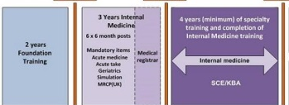
Training Pathway
New Consultant
Drug Development
Trials
Leadership
Continuing Professional Development
Research
Management
Teaching
International Conferences
Retirement
Survivorship
@acpuk
theacp.org.uk
Notes:
Training in medical oncology is 4 years.
In total (from medical school) it will be 8/9 years
However in the grand scheme – it is important to understand that you will be a consultant for many more years
Medical Oncology offers access to all those in this slide – and enables a fulfilling, rewarding and varied career.

Slide 21
What are the bits that no one else tells you?
International Conferences
Unparalleled Continuity in Patient care
Using cutting edge medicines and technologies – before they make the news!
Working in a large, collaborative team is great!
@acpuk
theacp.org.uk
Notes:
You may wish to talk about your highlights and why you would recommend it

Slide 22
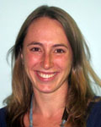
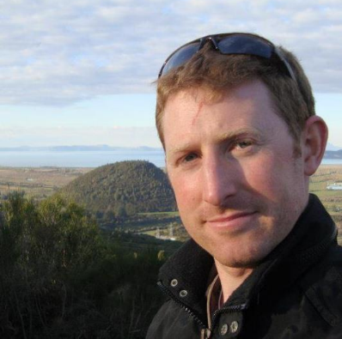
Why Choose Medical Oncology?
“
Making a difference at a very difficult time in people's lives. Many patients are not curative, however we do help patients feel better, improve their quality of life and enable patients to have more time to do the things that are important to them
”
Hester Franks
Medical Oncology Trainee Nottingham
“
Perfect balance of clinical and research interest. Epitomises bench to bedside care allowing the oncologist to be involved at every stage from the lab to the patient
@acpuk
theacp.org.uk
”
Mark Openhaw
Medical Oncology Trainee Leicester

Slide 23
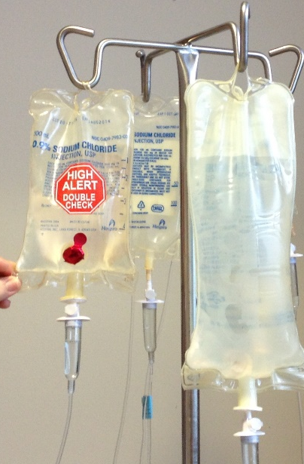
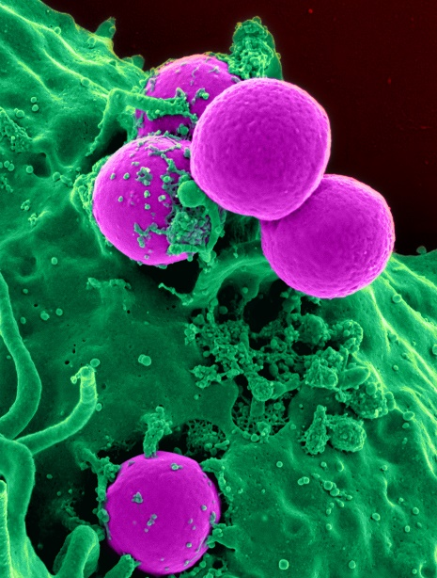
Exciting & Bright Future
Targeted and immune therapies
Genetics
Survivorship
1 in 2 people are affected by cancer
Precision Medicine & Immuno-oncology
Cytotoxic Chemotherapy
Increasing our understanding of the pathology of cancer has lead to many new treatments now and in the future
@acpuk
theacp.org.uk

Slide 24


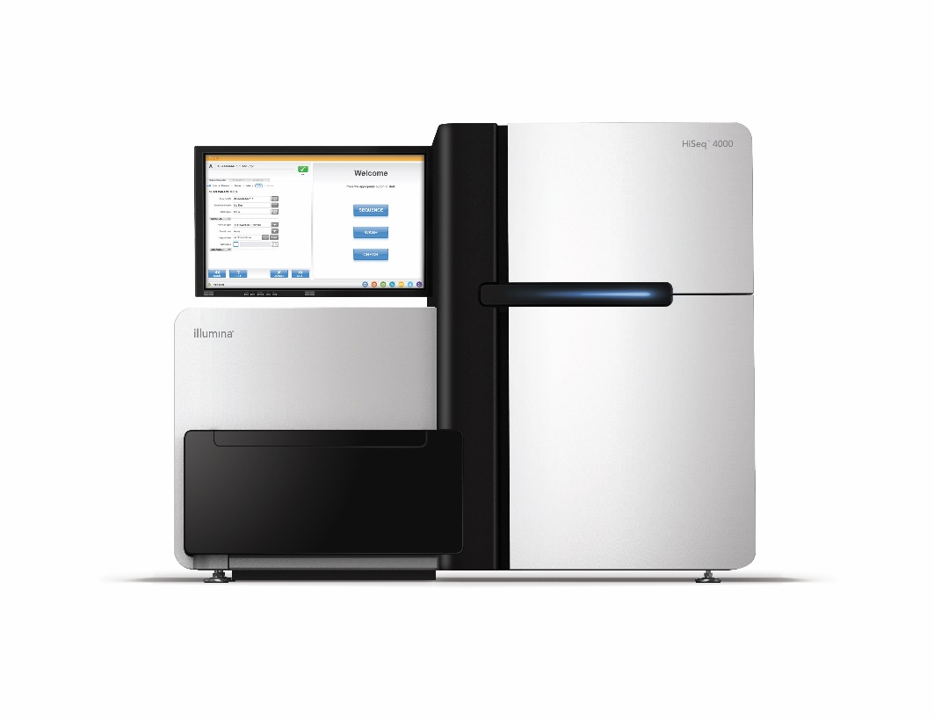
Exciting & Bright Future
Targeted and immune therapies
Genetics
Survivorship
1 in 2 people are affected by cancer
Understanding the genetic basis of cancer is revolutionising cancer care
This will become increasingly important for cancer prevention and treatment
@acpuk
theacp.org.uk
Notes:
HiSeq Sequencing machine
May wish to draw attention to 100k genome project

Slide 25
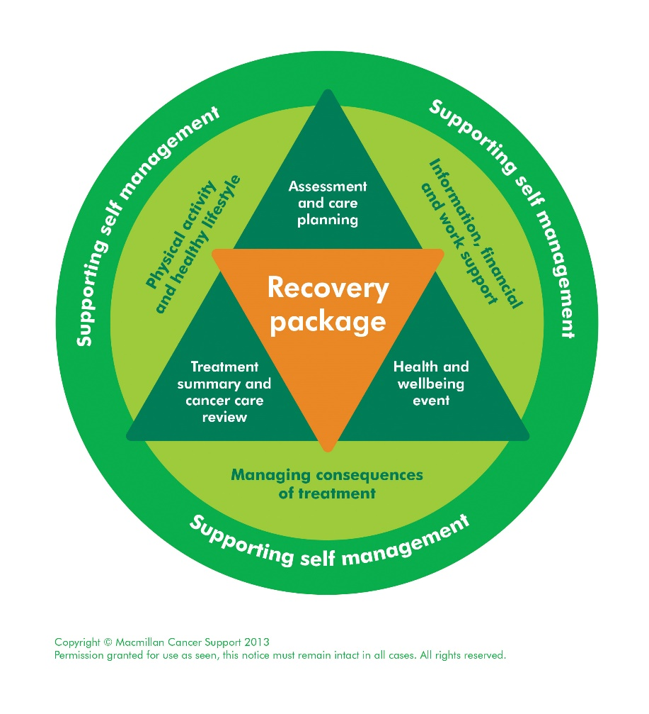
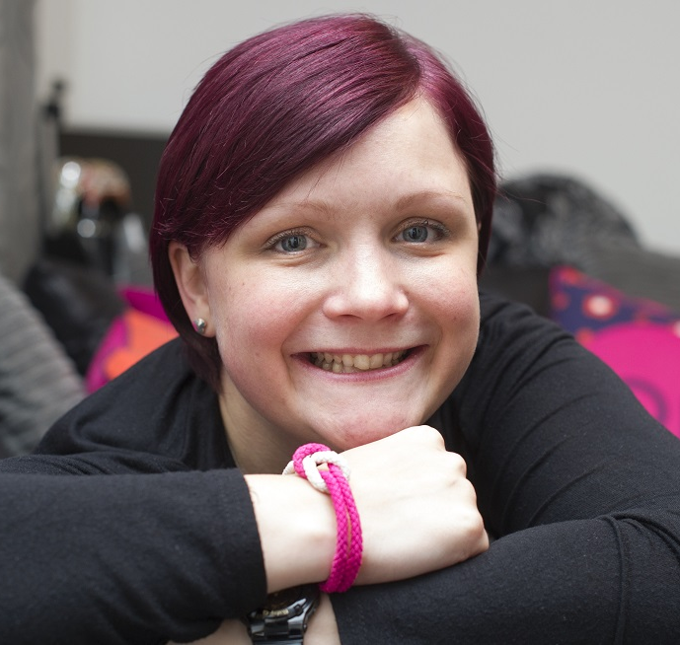
Exciting & Bright Future
Targeted and immune therapies
Genetics
Survivorship
1 in 2 people are affected by cancer
As more people are living with and surviving cancer there is much research and innovation to address the physical and psychological needs in survivorship and managing the late effects of cancer treatments
@acpuk
theacp.org.uk
Paisley .org.uk, Picture by Lesley Martin

Slide 26
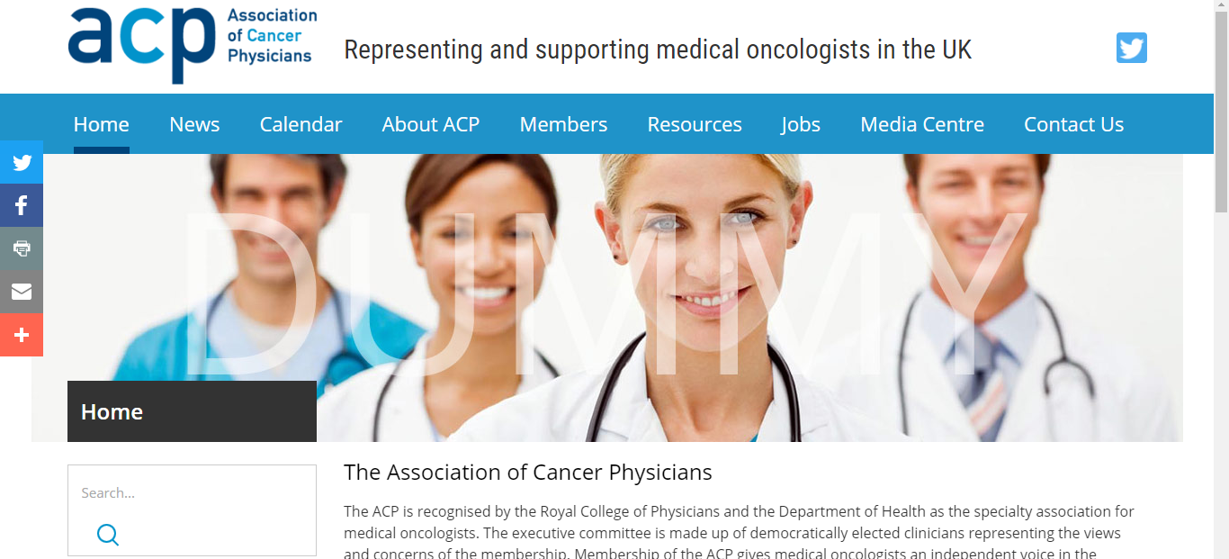
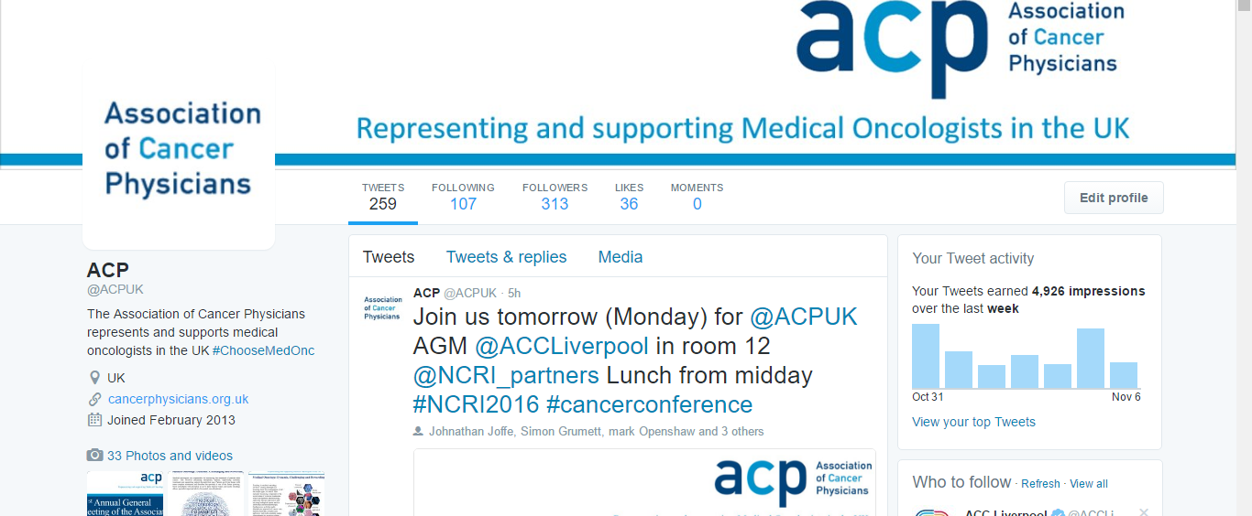
Keep up to date
Twitter
Website
@acpuk
theacp.org.uk

Slide 27
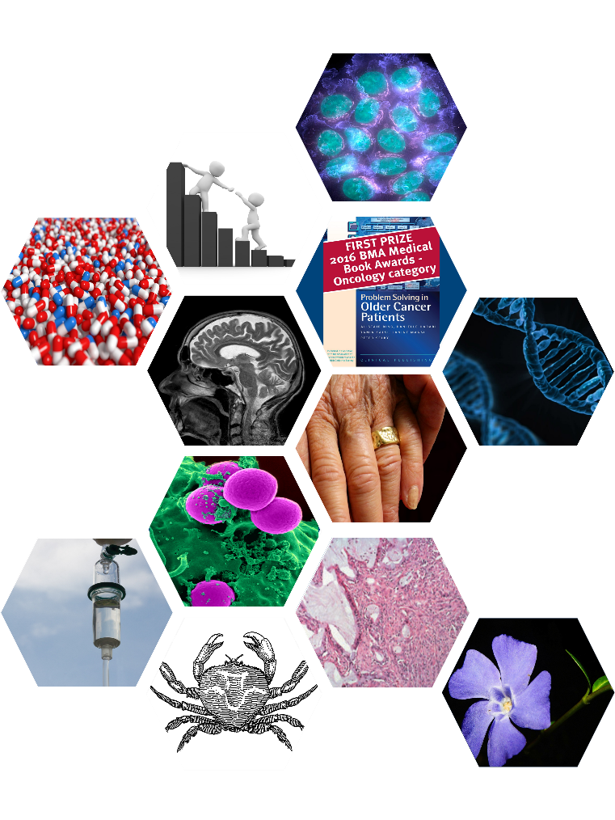
Find out more:
Please just ask!
Consider taster weeks
Get Involved – attend conferences, outpatients, taster weeks
We are always keen to meet with trainees thinking about medical oncology - we’re friendly and approachable!
theacp.org.uk - Further information and updates on prizes
rcplondon.ac.uk: search ‘Spotlight Medical Oncology’
Training pathway: jrcptb.org.uk/specialties/medical-oncology
Recruitment: st3recruitment.org.uk/specialties/medical-oncology
@acpuk
theacp.org.uk
Notes:
Students will often want contacts to sit in on clinics, contacts for taster weeks or to get involved with audits.
It is useful if not you, then you have some friendly oncologists who will be willing to engage with keen trainees
There is an associated leaflet and poster with this presentation that you may wish to print and distribute. It includes links to these websites and a broad overview of medical oncology – This can be downloaded from the ACP website.

