Slide 1
Representing and supporting Medical Oncologists in the UK
31st Annual General Meeting of the Association of Cancer Physicians
Monday 7th November 2016
Room 12, NCRI Conference, Liverpool
cancerphysicians.org.uk @acpuk

Slide 2
AGM
Agenda 2016
Welcome (JJ)
Apologies (AN)
Prizes (JJ)
Chair’s Summary (JJ)
Executive Committee update (JJ)
Meetings (RB)
Treasurer’s Report (MH)
Trainees Report (AJ)
SAC & Curriculum (AJ)
National Chemotherapy Board (JM)
New Members (AN)
AOB
Date of next meeting

Slide 3
Apologies for Absence
Jeremy Braybrooke
Andrew Protheroe
Andrew Davies
Chris Gallagher
Dan Stark
Alison Jones
Astrid Mayer
Anne Thomas
Sarah Danson
Michel Coleman
Jeff White
Rob Jones
Penella Woll
Jonathan Ledermann
Fiona Nussey
Ian Banks
Tariq Mughal
Paul Ross
Bruce Ponder
Caroline Michie
Zoe Kemp
Simon Grumett
Carey MacDonald-Smith
Anne Rigg
Alison Young
Udai Banerji
Adam Dangoor
James Larkin
Roshan Agarwal
Peter Clarke

Slide 4
ACP Prizes
McElwain Prize – Dr Andrew Furness – Clonal Neoantigens elicit T cell immunoreactivity and sensitivity to immune checkpoint blockade
Undergraduate Prizes:
  1st Prize – Yu Hsuen Yang, UCL Medical School
  Runner up – Will Quah, Brighton and Sussex Medical School
  Junior Doctor Prizes:
  1st Prize – Dr Sarah Guthrie, FY2, Edinburgh
  Runner up – Dr Catherine Sedgewick, FY2, South Thames

Slide 5
Chair’s Summary
Achievements
Growth of the Specialty and Workforce issues
National Cancer Transformation Board / INCAG
Cancer Alliances
Cancer Dashboards
Progress with Meeting Makers
Board of Trustees
Honorary Members
Fellows of the ACP
Training Issues

Slide 6
Achievements
New Executive Structure
ACP Strategy
Meetings Programme
Publications
Peer Support Programme
ESMO Discount
Working with Meeting Makers – New Website & Database
Engagement with Trainees
Promotion of the Specialty
Thanks

Slide 7
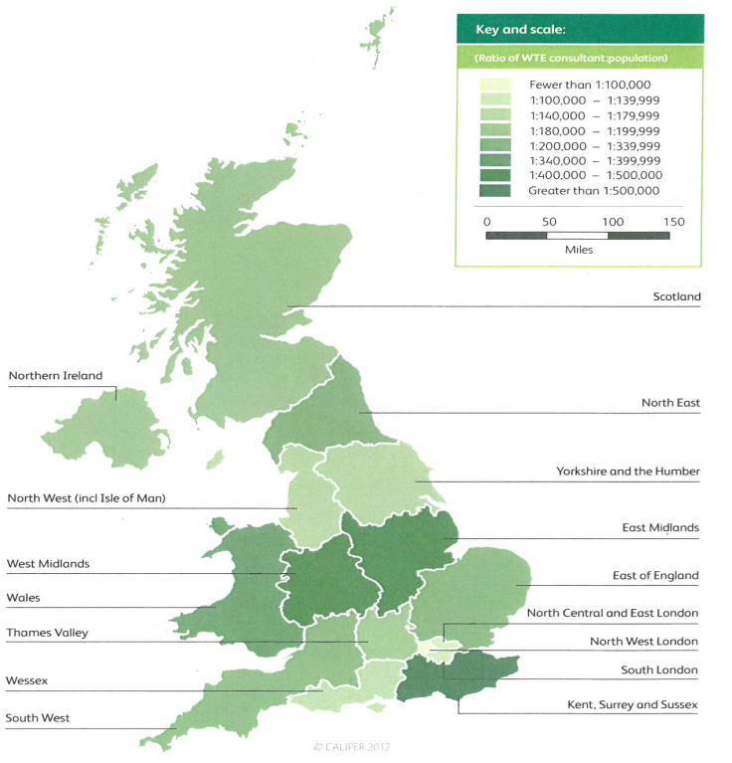

Slide 8
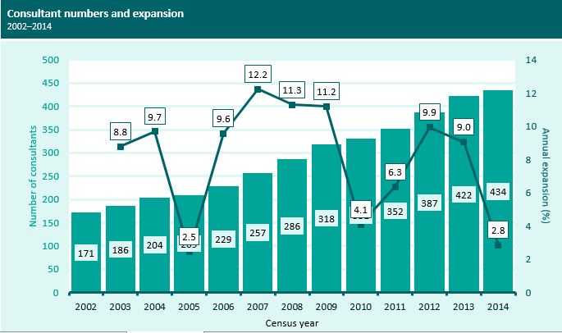
RCP Census 2015 – medical Oncology data

Slide 9
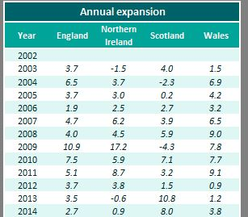
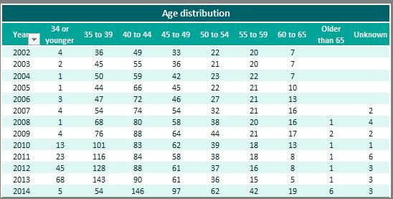

Slide 10
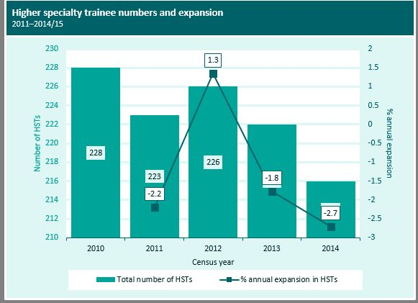
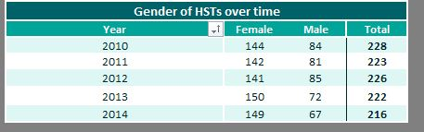

Slide 11
Is the trainee pool large enough?
216 Trainees distributed over 4 years would generate 54 new consultants per year.
Distributed over an average of 6 years (higher degrees) will generate approximately 36 consultants per year
Over 5 years = 180 consultants
Approximately 60 will retire in the next 5 years (120 in next 10 years)
So expansion will be limited to 60 = 13% over 5 years = 2.6% / year
ACP Strategy aspiration is for 1:100000 by 2020 = 600
@2.6% we would have 550 in 2020
Getting to 900 will take 25 years.
We need 6.5 % growth to reach 900 by 2025

Slide 12
National Cancer Transformation Board
Achieving World-Class Cancer Outcomes: Taking the strategy forward March 2016
“Building on the Taskforce report, HEE will baseline the current state of the cancer and related workforce, identifying current gaps and drivers for those gaps, reporting in June 2016. We will use the baseline, along with a projection of the future planned workforce based on current demand, to address capacity issues by developing an action plan by September 2016, including any plans for international recruitment”.

Slide 13
Workforce - Current status
Transformation Board working with HEE
CRUK has commissioned an independent project on Non-surgical Cancer workforce.
ACP and RCR have supported a bid from 2020 Delivery
CRUK have asked 2020 to work with a 2nd bidder (Institute for Employment Studies – IES) as a joint project
We will endeavour to assure a transparent and unbiased assessment of current status and needs
Membership database may be important so please complete all relevant fields !

Slide 14
Cancer Alliances
“The NHS will also set up Cancer Alliances made up of clinical and other local leaders from across different health and care settings. These alliances will review all data for their area – including survival, early diagnosis rates, treatment outcomes, patient experience and quality of life – and use it to pinpoint areas for local improvement”.
These are not “cancer networks” They may provide some support but are essentially loco-regional commissioning groups
They will align with the STPs (Sustainability and Transformation Plans)
- High level strategic commissioning groups – This is about efficiency and saving money!

Slide 15
Cancer Vanguards
“The cancer vanguards are piloting various new models of care in three sites across the country”.
“Consideration of vanguards in other health economies in the coming years”.
“There is a significant opportunity to transfer the substantial learnings from the vanguards into the work of the Alliances as they are established”.
“However it must be noted that not all aspects will be transferable without huge investment, even accepting the potential savings from working collaboratively. There is therefore a need to consider other mechanisms for spreading best practice and ensuring all areas of the country are well placed to drive improvements”.
Vanguards may not be representative of “typical” cancer economies.

Slide 16
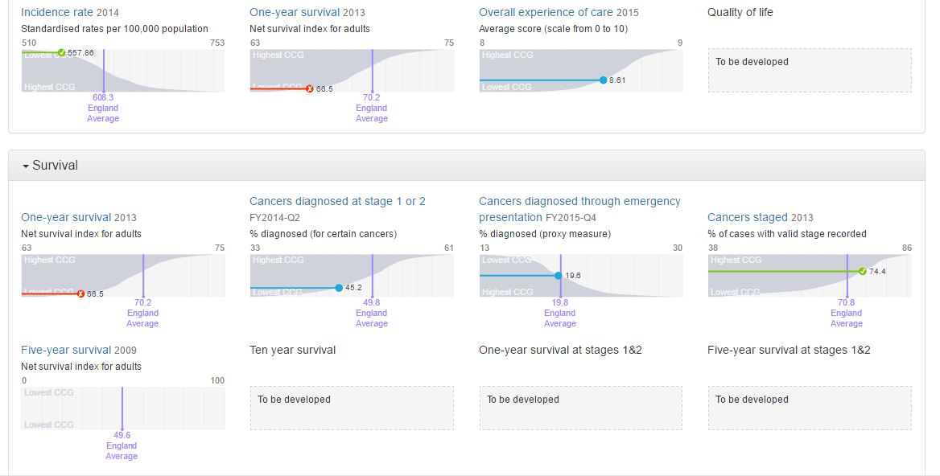
Cancer Dashboards https://www.cancerdata.nhs.uk/dashboard#?tab=Overview

Slide 17
Meeting Makers
Work is behind schedule, but significant progress has been made in last 2 months
New membership database
New Subscription rates (Lower) and payment methods
New Logo
New Website www.theacp.org.uk
Meetings management
PLEASE LOOK OUT FOR THE EMAILS THAT WILL ALLOW YOU TO ACTIVATE YOUR NEW REGISTRATION AND MEMBERSHIP

Slide 18
Board of Trustees
Dr Alison Jones
Professor Richard Begent
Dr Chris Gallagher

Slide 19
Exec Cttee and JSC Update
ACP Executive
Deputy Chair – Vacant
Hon Treasurer – to be remodelled with support
Chair – term 1 more year.
JSC
College representatives – closes 1/11/16
https://www.rcplondon.ac.uk/education-practice/volunteering/new-member-sought-joint-specialty-committee-medical-oncology

Slide 20
Meetings – Dr Ruth Board
Late Medical Effects of Cancer Treatment Conference (RCP London) – 11th November 2016
New Consultants Group Meeting, Manchester – 18/19th March 2016
Discussing an annual Spring Meeting with AGM
Educational Workshop on Immunotherapies – 13th October 2017 - Manchester
Cancer Physicians in Training Weekend – 14/15th October 2017 - Manchester

Slide 21
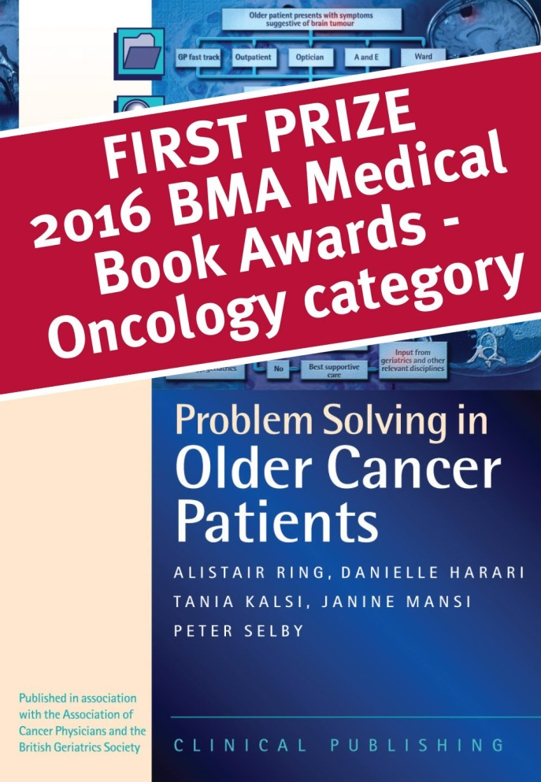
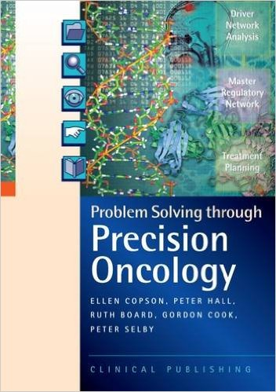
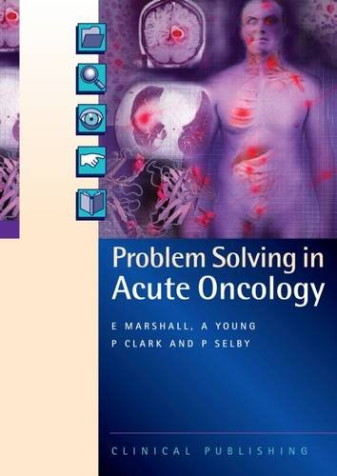
ACP publications

Slide 22
ACP Strategy
Published on eCancer (2015)
Updates and implementation in progress

Slide 23
Honorary Members and Fellows
ACP has long had facility to create Hon members and has used this facility for the first time with respect to outside contributors to the strategy. – Hon members are expected to have ambassadorial function for the ACP
You can nominate persons to the Exec Committee via Alison Norton
Fellows – new concept. In recognition of significant contributions over time
Limited number of senior ACP contributors and Non-ACP Hon fellows. Never more than 5% of numbers of full members.
Needs approval by the AGM
Not a money generating scheme!
Nominations to Exec Board – will be an annual election / selection process approximately 5 awards / year.

Slide 24
Current Honorary Members
Professor Ian Banks (Belfast)
Professor Adam Glaser (Leeds)
Dr Danielle Harari (London)
Dr Tania Kalsi (London)
Mr Mark Flannagan (Beating Bowel Cancer)
Dr Alex Mitchell (Leicester)
Professor Richard Neal (Bangor)
Dr Emily Shaw (Southampton)
Dr Michel Coleman (London)

Slide 25
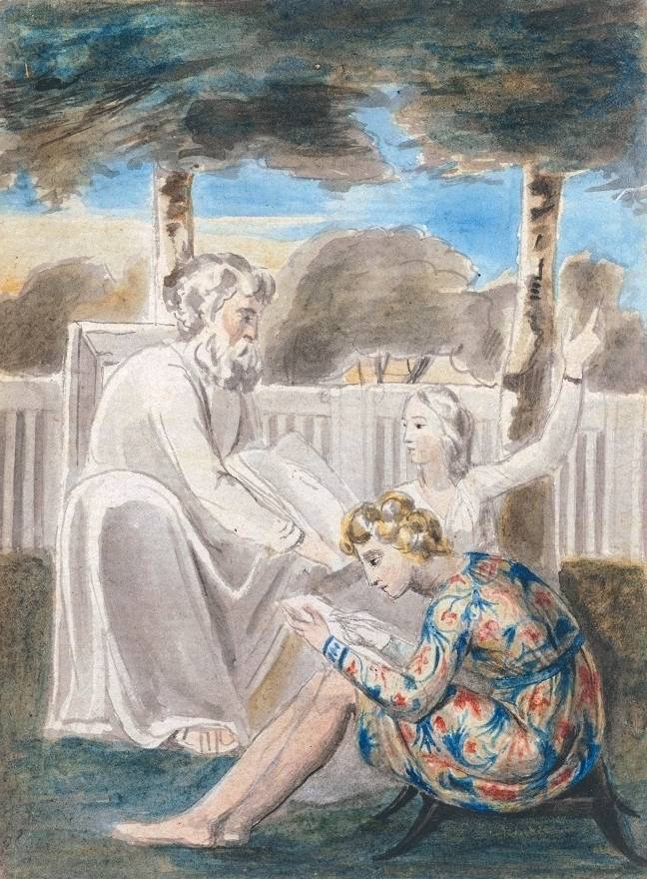
Specialist Peer Support for New Consultants
Cancer-site specific mentorship
Part of our strategy to support consultant members.
For first 3 - 5 years after first appointment
For changes in sub-specialisation
Please complete this section when you register on the new membership database.
William Blake's watercolor of "Age teaching youth”

Slide 26
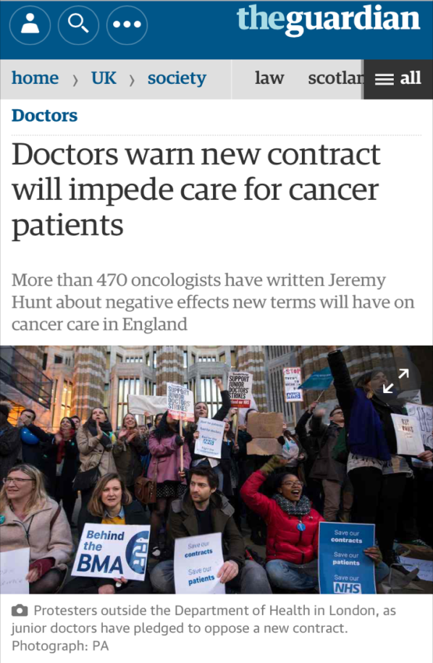
Junior Doctors Contract
The proposed (imposed) contract is likely to adversely affect medical oncology due to its impact on those trainees who take time out of programme or work less than full time.
Surveys and public statements
Collaboration with the Junior Registrars Forum of the RCR
Aim to apply for an ‘exceptional specialty’ to mitigate for the impact of the imposed contract
@acpuk
cancerphysicians.org.uk

Slide 27
Shape of Training
Most recent iteration:
Medical Oncology will NOT dual accredit with internal medicine
Medical Oncology will NOT be part of the unselected take
CMT3 year (pre-specialisation)
Contribute to the medical take through AOS (Acute selected take)
@acpuk
cancerphysicians.org.uk
Notes:
The proposal is still being finalised. Shape of Training is now an ‘evolution’ rather than a ‘revolution’. It aims to equip the future consultants with the medical skills, knowledge and experience to treat increasingly complex and elderly patients within their field of practice.
Medical oncology will not be part of the acute, unselected take and it will not dual accredit with internal medicine. It will instead contribute through ‘selected take’ as part of acute oncology services. It is therefore of increasing importance that acute oncology services are effective as this reduces the burden on the acute unselected take.
This model does not propose a shortening to our training, rather an extra year of ‘CMT3’ prior to specialisation. Overall the ACP remains in support of the concept of more exposure to general medicine at this level.
New Curriculum for Internal Medicine in line with ‘Shape of Training’:
https://www.jrcptb.org.uk/sites/default/files/V19%20Internal%20Medicine%20curriculum%20proposal%20260216.pdf
A new model of assessment – ‘Competencies in Practice (CiP)’ is being developed with the aim of simplifying workplace-based assessments. It is currently under review as part of a pilot study prior to further implementation: https://www.jrcptb.org.uk/training-certification/shape-training-and-new-internal-medicine-curriculum/cip-proof-concept-study

Slide 28
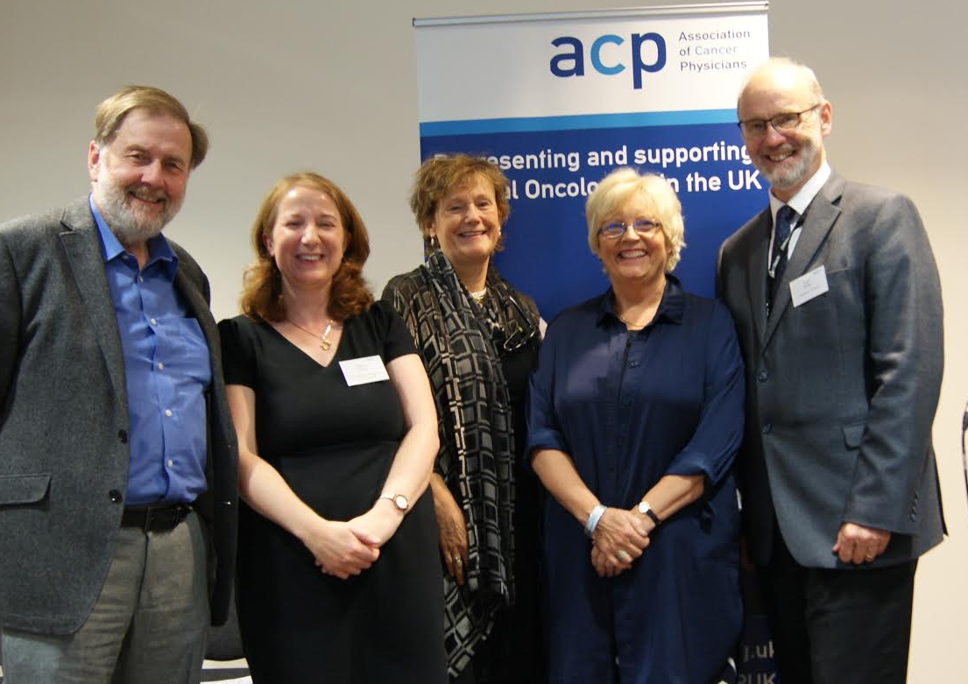
Trainees Weekend – Free to members
Annual Cancer Physicians in Training Weekend – 2016
120 trainees
Speakers included Professor Chris Harrison (National Clinical Director for Cancer), Professor Ian Judson, Professor Mark Bower, Professor David Dodwell, Dr Susana Banerjee, Mr David Chang
@acpuk
cancerphysicians.org.uk
Annual Study Workshops
2016 - Patient Centred & Integrated Cancer Care

Slide 29
New Curriculum
Chemotherapy competencies will soon be included in e-portfolio
Change in the medical oncology curriculum (has been passed to GMC for ratification and will be introduced in 2018 for all trainees >18/12 from CCT (and those <18/12 may choose to migrate onto the new curriculum).
New proposed curriculum:
Upper GI 6/12
Skin and Melanoma 4/12
Urology 4/12.
Updated ARCP guide that is adjusted to provide a more realistic and achievable outcome for leadership and research
Quality improvement projects rather than audits
@acpuk
cancerphysicians.org.uk
Notes:
The proposal is still being finalised. Shape of Training is now an ‘evolution’ rather than a ‘revolution’. It aims to equip the future consultants with the medical skills, knowledge and experience to treat increasingly complex and elderly patients within their field of practice.
Medical oncology will not be part of the acute, unselected take and it will not dual accredit with internal medicine. It will instead contribute through ‘selected take’ as part of acute oncology services. It is therefore of increasing importance that acute oncology services are effective as this reduces the burden on the acute unselected take.
This model does not propose a shortening to our training, rather an extra year of ‘CMT3’ prior to specialisation. Overall the ACP remains in support of the concept of more exposure to general medicine at this level.
New Curriculum for Internal Medicine in line with ‘Shape of Training’:
https://www.jrcptb.org.uk/sites/default/files/V19%20Internal%20Medicine%20curriculum%20proposal%20260216.pdf
A new model of assessment – ‘Competencies in Practice (CiP)’ is being developed with the aim of simplifying workplace-based assessments. It is currently under review as part of a pilot study prior to further implementation: https://www.jrcptb.org.uk/training-certification/shape-training-and-new-internal-medicine-curriculum/cip-proof-concept-study

Slide 30
New Trainees Committee
The ‘ACP Trainees committee’ will represent trainees within the association
It aims to promote the association, provide educational opportunities and aid networking between trainees
The committee will co-ordinate activities and ensure that representatives are present at meetings where a trainee should be a stakeholder
The committee will meet twice a year (1 x ACP Trainees weekend – October, 1x (proposed) Spring Study day) and have 2 teleconferences in between these times
@acpuk
cancerphysicians.org.uk
Notes:
The proposal is still being finalised. Shape of Training is now an ‘evolution’ rather than a ‘revolution’. It aims to equip the future consultants with the medical skills, knowledge and experience to treat increasingly complex and elderly patients within their field of practice.
Medical oncology will not be part of the acute, unselected take and it will not dual accredit with internal medicine. It will instead contribute through ‘selected take’ as part of acute oncology services. It is therefore of increasing importance that acute oncology services are effective as this reduces the burden on the acute unselected take.
This model does not propose a shortening to our training, rather an extra year of ‘CMT3’ prior to specialisation. Overall the ACP remains in support of the concept of more exposure to general medicine at this level.
New Curriculum for Internal Medicine in line with ‘Shape of Training’:
https://www.jrcptb.org.uk/sites/default/files/V19%20Internal%20Medicine%20curriculum%20proposal%20260216.pdf
A new model of assessment – ‘Competencies in Practice (CiP)’ is being developed with the aim of simplifying workplace-based assessments. It is currently under review as part of a pilot study prior to further implementation: https://www.jrcptb.org.uk/training-certification/shape-training-and-new-internal-medicine-curriculum/cip-proof-concept-study

Slide 31
Treasurers Report- Dr Marcia Hall
Solvent
Collecting Subscriptions
New system through Meeting Makers
Last 2 meetings run at loss
Novel partnerships and sponsorships in planning

Slide 32
National Chemotherapy Board
Established 2014
Representation from SACT, CRG, Patient Representatives
Respond to national issues and create/share national guidelines, service improvement

Slide 33


National project:
Regimen-specific consent forms
Practice of consent for SACT varies in the UK
Project to develop a national library of SACT regimen-specific consent forms initiated in 2015
Cancer Research UK (CRUK) awarded a grant to GSTT to host the project
The National Chemotherapy Board are the governing body for the project:

Slide 34
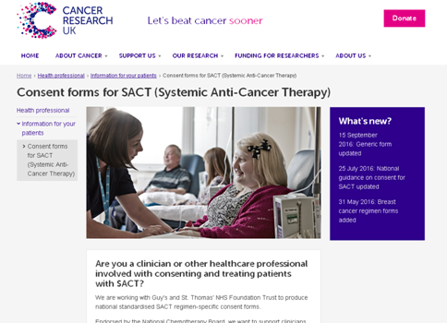
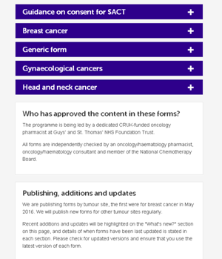
Created the webpage
To host the forms and associated documents: www.cruk.org/sact_consent

Slide 35
National Forms
5-page form
Standard template
Notes:
5-page form
Summarise contents of each
35

Slide 36
National Chemotherapy Board:
Mortality within 30 days of Systemic Anti-cancer Therapy (SACT): led by Dr Paula Scullin
Review of current practice
        Suggested standardised review
Good practice guideline: Promoting early identification of systemic anti-cancer therapies side effects – two approaches: led by Dr Catherine Oakley (President of UKONS)
ABC Project: Age is no Barrier to Chemotherapy: led by Dr Janine Mansi in conjunction with POI/ABPI

Slide 37
Chair changes each year – next joint UKONS and BOPA
Continue to
Develop Good Practice Guidelines for national use
Liaise with CRG and CCGs
Liaise with PHE SACT
Research/service improvement with a national interest

Slide 38
New Members – Alison Norton
Sasha Badzek
Tariq Mughal
Kirsty Ross
Tim Robinson
Colin Barrie
Julien de Naurois
Carey Macdonald-Smith
Georgina Wood
Peter Gallagher
Gary Doherty
Deiva Venkatachala
Claire Dyke
Helen Creedon
Laura Spiers

Slide 39
Date for Next Meeting
TBC – Keep an eye out for ...

Slide 40

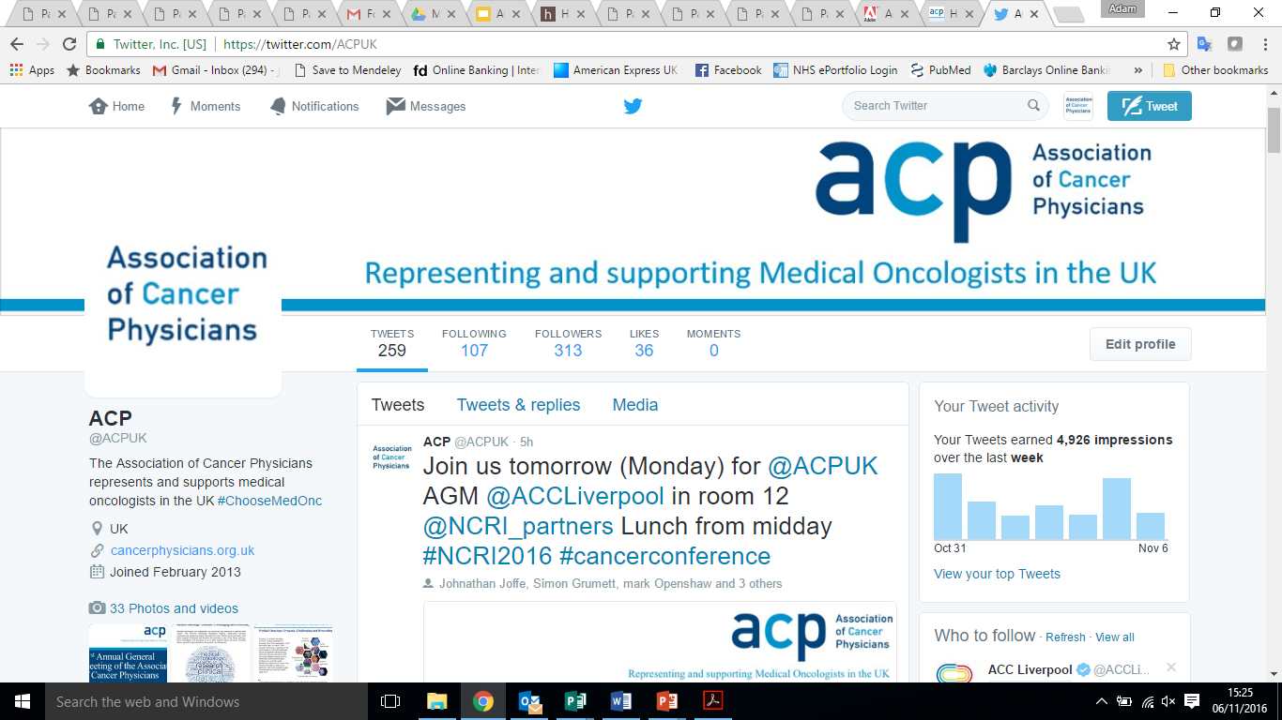
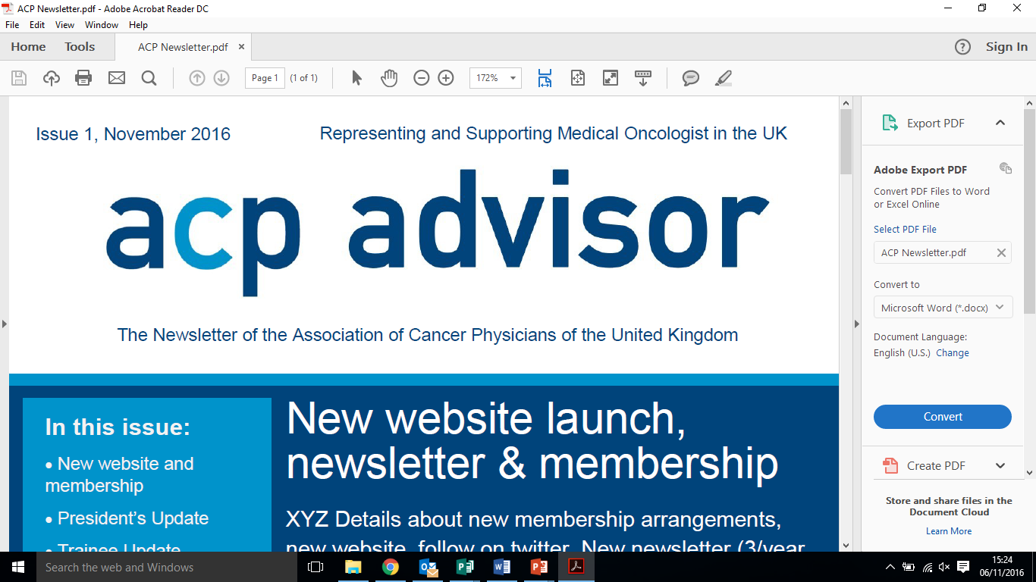
Keep up to date
New Newsletter
Twitter
New Website
@acpuk
cancerphysicians.org.uk

Slide 41
Representing and supporting Medical Oncologists in the UK
31st Annual General Meeting of the Association of Cancer Physicians
Monday 7th November 2016
Room 12, NCRI Conference, Liverpool
cancerphysicians.org.uk @acpuk

